Slide 1
Capstone 1 Fraud Detection Agent with RAG Joel Hines, Jesse Wilkinson, Chao Li

Slide 2
Problem Statement
Financial institutions process millions of credit card transactions daily, but traditional fraud systems often stop at a risk score. Analysts are left with high-risk alerts and limited context on why a transaction is suspicious or which policy rules apply. The result is slow investigations, inconsistent decisions and limited auditability for regulatory review.
What This Capstone Project Delivers
An agentic fraud investigation system combining a trained ML classifier with a retrieval-augmented agent on AWS. Given a batch of transactions, the system will:
Score fraud risk using a trained SageMaker model
Escalate the highest-risk cases for investigation
Retrieve relevant fraud rules from a knowledge base using Retrieval Augmented Generation (RAG)
Enrich with customer context and history
Generate structured, explainable investigation reports with a recommended action
Audit every step of the agent's reasoning
Notes:
Joel

Slide 3
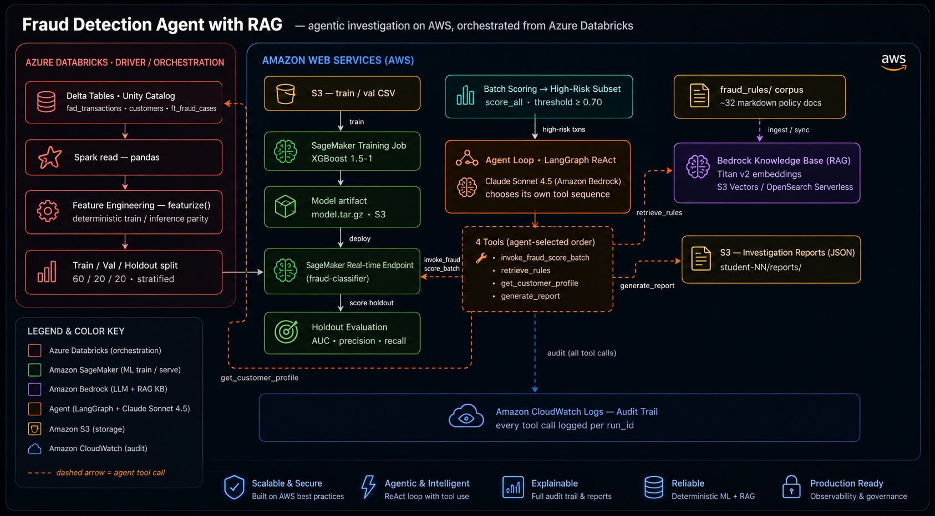
Architecture
Notes:
Joel

Slide 4


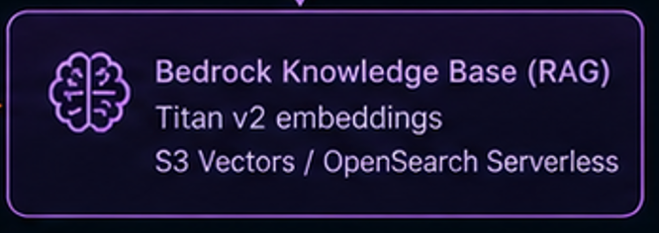
Data Sources
Tabular Data in Databricks
Transaction Data | Customer Account Profiles
`bread_academy.course_data.fad_transactions` 50,000 card authorizations from Fiserv FAD feed ~3% confirmed fraud Key signals: amount, merchant type, payment entry mode, country, device, card verification value (CVV), address verification outcome (AVS), velocity | bread_academy.course_data.customers 5,000 customer account profiles Includes customer tenure, average monthly spend, credit score band, delinquencies Risk tier derived from real fraud history
Policy Documents for Retrieval Augmented Generation
Fraud Policy Corpus
fraud_rules/ (32 Policy Documents → Bedrock KB) AML thresholds, velocity rules, MCC risk, geographic risk Card-not-present heuristics, device anomalies Ingested into RAG knowledge base in Bedrock for policy retrieval
Top-matching rules are returned with relevance scores
The agent cites these rules in its decision rationale
When the agent investigates a transaction, it doesn't guess — it retrieves the actual policies that apply:
Transaction signals (high velocity, foreign country, crypto MCC) form a natural-language query
The query is embedded and matched against the indexed policy corpus

Slide 5
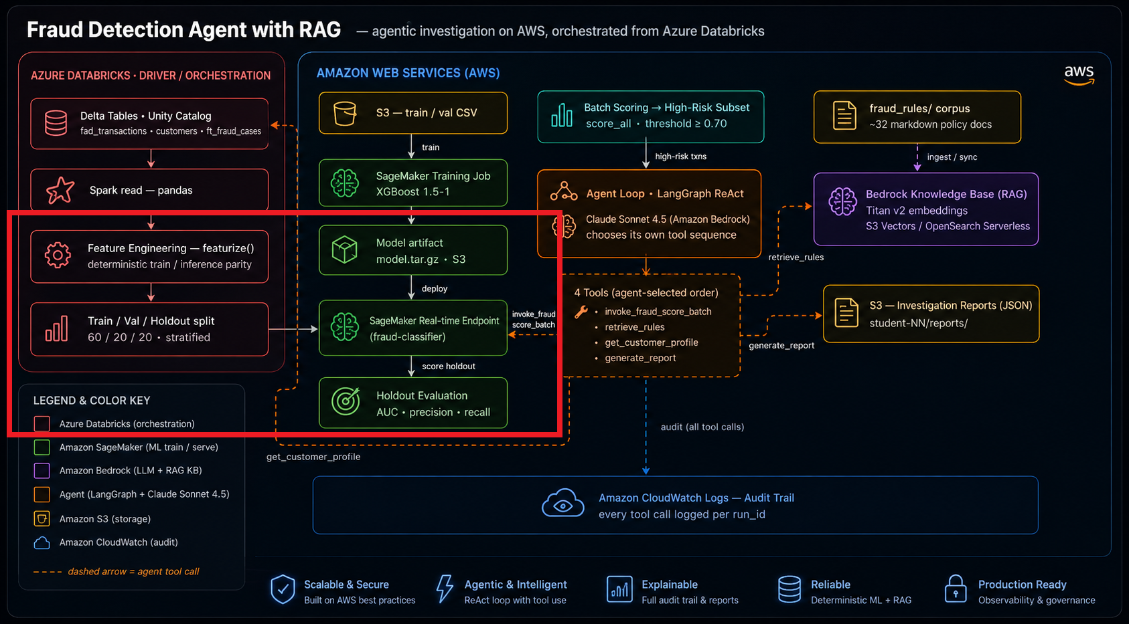
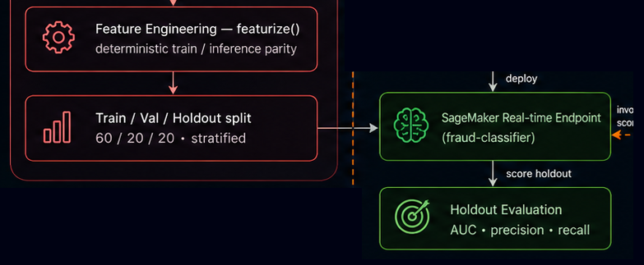
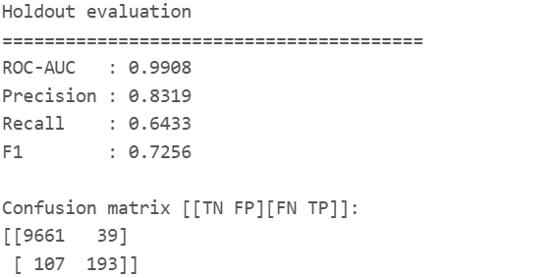
Fraud Risk Model
19 Features Derived: including 'tran_amt', 'card_not_present', 'foreign_country', 'high_risk_mcc', 'cvv_fail', 'avs_fail', 'odd_hour_txn'
Hyperparameter Tuning: 'validation:auc' 'Maximize', max_jobs=10, strategy='Bayesian' >>>Best AUC: 0.9887
Holdout Evaluation: 10000 scored holdout
(60/20/20 Split: train=30000,
validation=10000, holdout=10000,
confirmed_fraud=1500 )

Slide 6
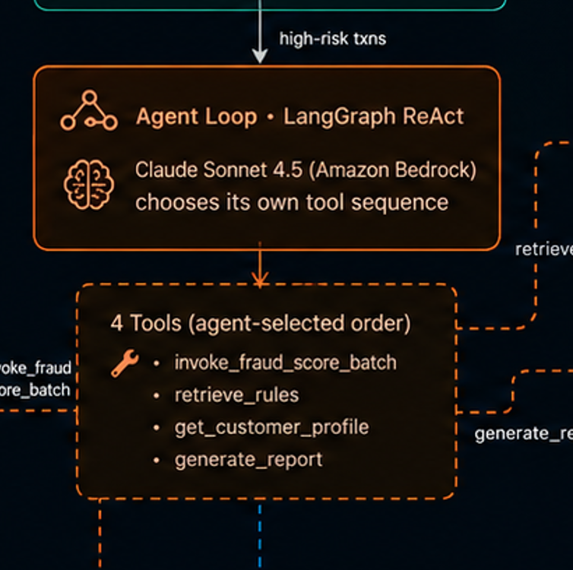
ReAct Agent
Reason, Act, and Iterate
A single ReAct agent loop to evaluate a transaction. We hand the four tools to `create_react_agent` and let the model decide the order:
Look up the risk score
Retrieve the relevant fraud rules for more context using RAG
Pull the customer profile if context is needed
Write the report with a decision of ESCALATE, MONITOR, or CLEAR
All steps that the Agent takes are logged to AWS Cloudwatch, and its rationale is included in the exported report to S3 as evidence for our decision determination.

Slide 7
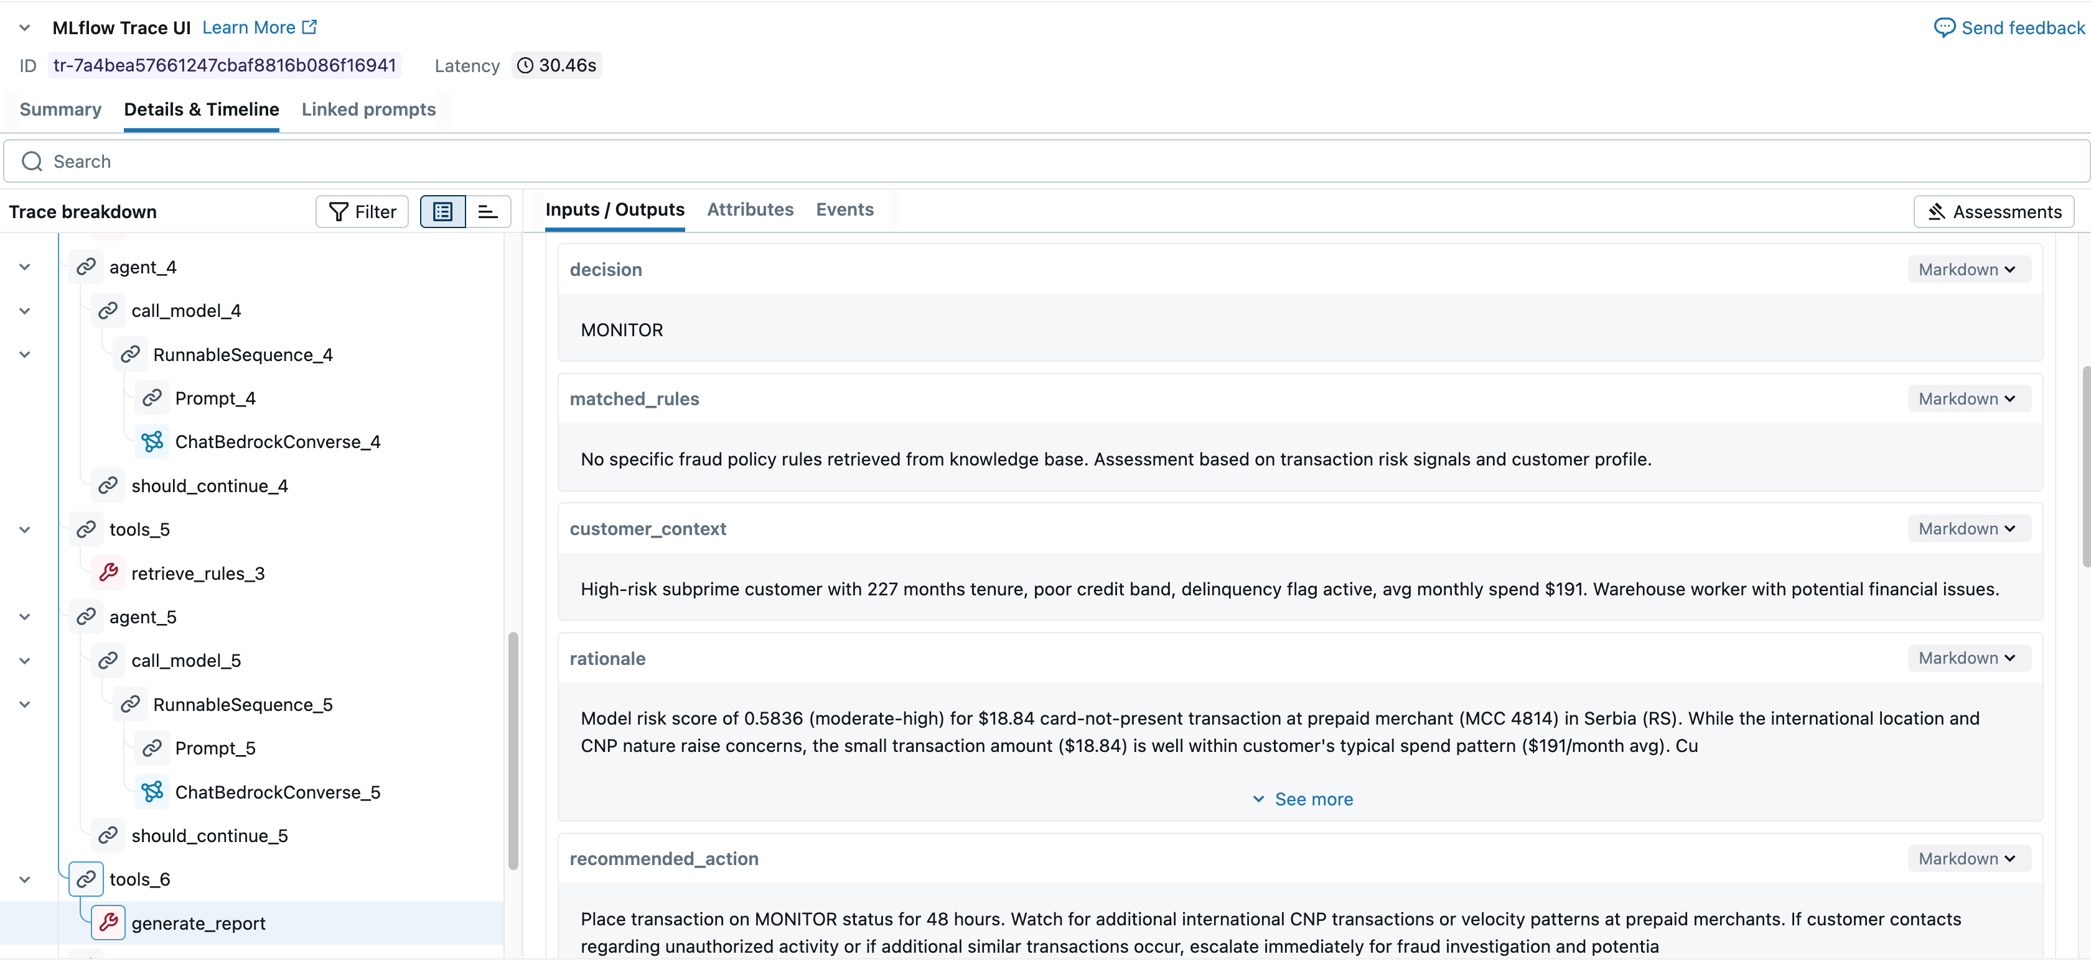
Running It Altogether
By orchestrating these components into an end-to-end pipeline, we flag high-risk transactions for agent review, evaluate each case with ML, RAG, and customer context tools, and produce an auditable report with a decision: CLEAR, MONITOR, or ESCALATE.

Slide 8
Demo

